Slide 1

Java PrintWriter class
The Java PrintWriter class (java.io.PrintWriter) enables you to write formatted data to an underlying Writer. For instance, writing int, long and other primitive data formatted as text, rather than as their byte values.
The Java PrintWriter is useful if you are generating reports (or similar) where you have to mix text and numbers. The PrintWriter class has all the same methods as the PrintStream except for the methods to write raw bytes. Being a Writer subclass the PrintWriter is intended to write text.
The Java PrintWriter class contains the powerful format() and printf() methods. The two methods do exactly the same, but the name "printf" is more familiar to C-programmers. The format() and printf()methods allow you to mix text and data in very advanced ways, using a formatting string.
PrintStream
Writer
PrintWriter
Java Application
Write
Write

Slide 2
Java PrintWriter class
Writer
PrintWriter

Slide 3
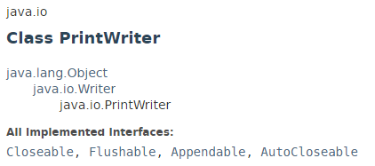
Java PrintWriter class

Slide 4
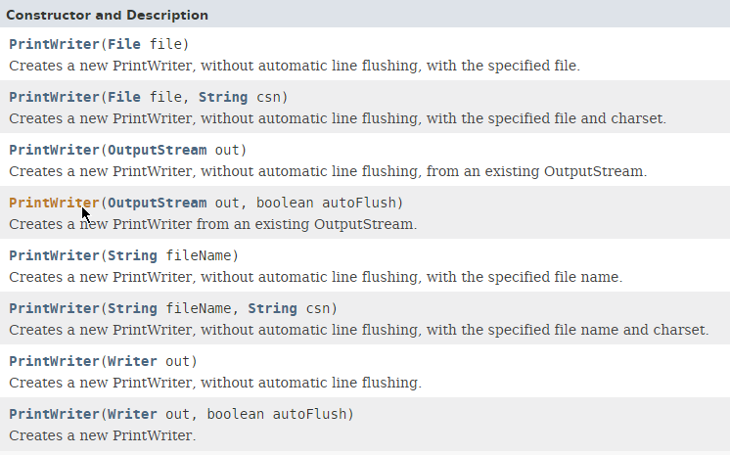
Java PrintWriter class

Slide 5
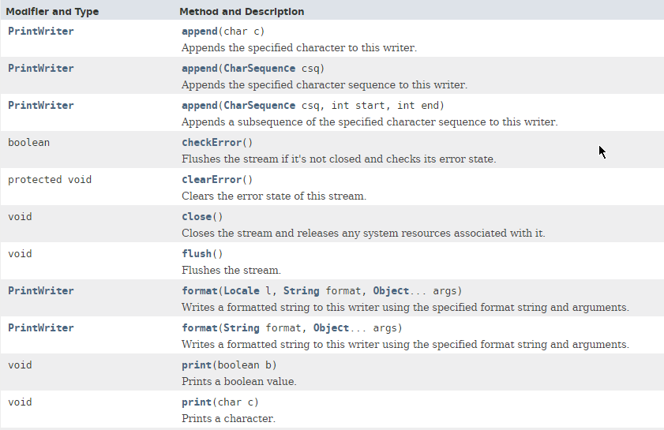
Java PrintWriter class

Slide 6
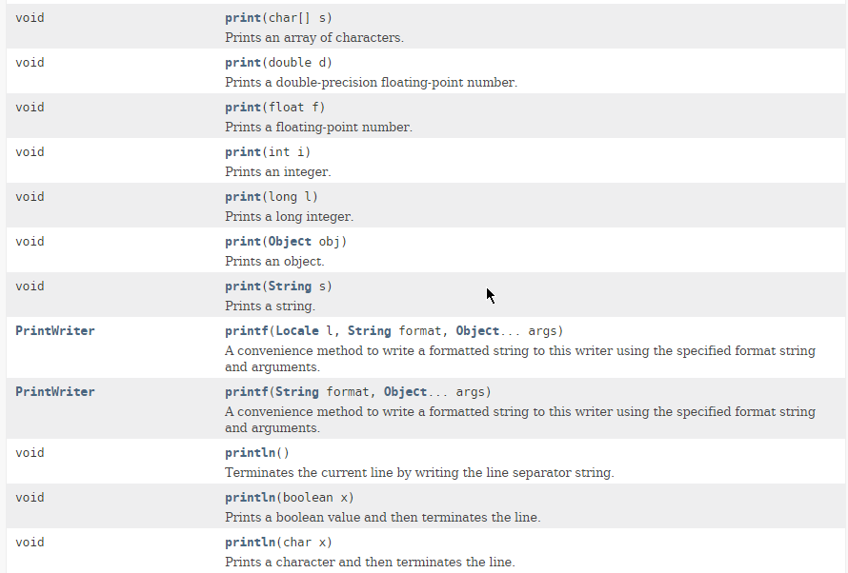
Java PrintWriter class

Slide 7
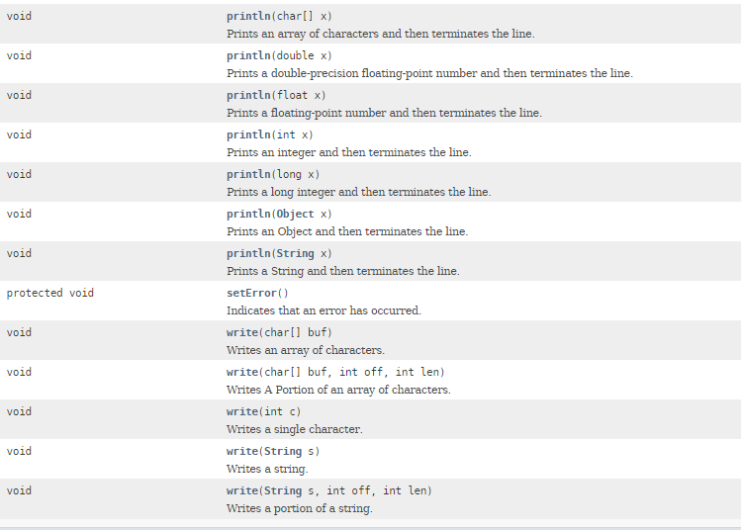
Java PrintWriter class

Slide 8
Java PrintWriter class
https://docs.oracle.com/javase/8/docs/api/index.html?java/io/PrintWriter.html

